Slide 1
Interfaces and Abstract Classes
Forced Behavior

Slide 2
Using Abstract Classes
Abstract class cannot be instantiated
Normally used as the base class in an inheritance hierarchy
This provides a template for all derived classes
Derived classes of an abstract class that can be instantiated are called concrete classes

Slide 3
Abstract Classes
Use the keyword abstract
public abstract class Person{
…
}

Slide 4
Abstract Methods
Use the keyword abstract
Must be overridden by derived classes
Must be in an abstract class
public abstract int getAge();

Slide 5
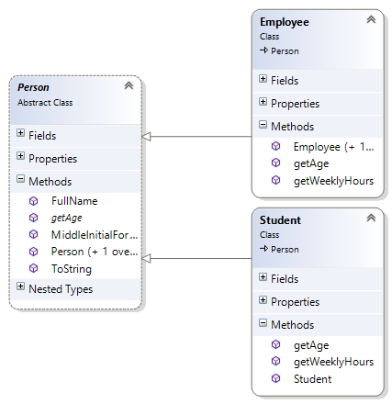
Class Diagram

Slide 6
Interfaces
Specify what operations can be performed - not how they are implemented
Think of interfaces as a “Template”
Assign a common functionality to possibly unrelated classes
Classes that implement the same interface respond to the same method calls (polymorphism)
Similar to abstract classes but classes do not need to be related in an "is-a" relationship
Allows “multiple inheritance”

Slide 7
Can also be done with Interfaces
IMagic
+castSpell()
IMagic
IMagic
IMagic
Wand
+castSpell()
Wizard
+castSpell()
Artifact
+castSpell()

Slide 8
Applying Interfaces
public interface IMagic {
void castSpell();
}
public class Wand : IMagic {
}
public class Wizard : IMagic {
}
public class Arifact : IMagic {
}

Slide 9
Implementation
Methods declared must be implemented by the class that implements the interface
Cannot contain fields (class variables);
public interface IPayable {
double getWeeklyWage();
double getBiWeeklyHours();
}

Slide 10
Using
class Employee:Person, IPayable {
double _Wage;
… // other code
public double getWeeklyWage() {
return getWeeklyHours() * _Wage;
}
public double getBiWeeklyHours() {
return getWeeklyHours()*2;
}
}

Slide 11
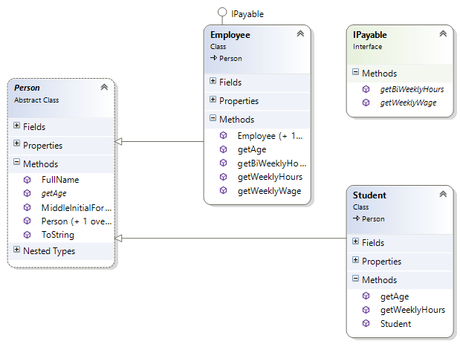
Class Diagram

Slide 12
Interfaces Cannot Be Instantiated
Cannot instantiate objects of the Interface type
Can use Interface as a reference type
IPayable myEmp = new Employee();

Slide 13
Copying Data
Shallow Copy
Copies references to the data to the new object
Deep Copy
Copies values of the data to the new object

Slide 14
Shallow Copy
Stack
Heap
a
b
#A4
#A4
63
12
83
50
26
#A4
b = a

Slide 15
Deep Copy
Stack
Heap
a
b
#A4
#A4
63
12
83
50
26
#F7
#F7
63
12
83
50
26

Slide 16

Example
Nicknames (Aliases)
Shallow Copy
Identical Twins
Deep Copy
Robert
Bob
Tim
Tom

